Slide 1
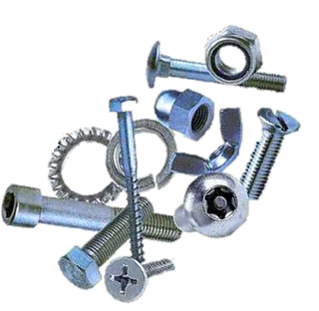

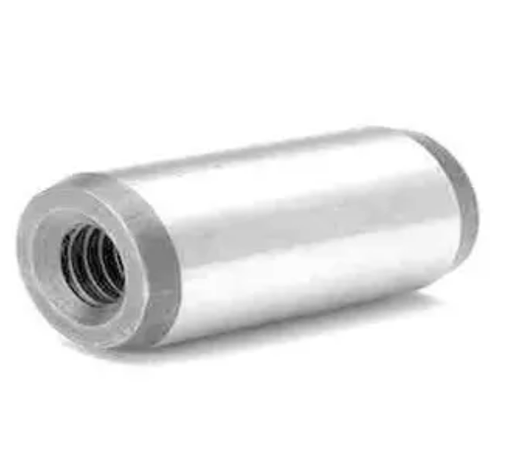
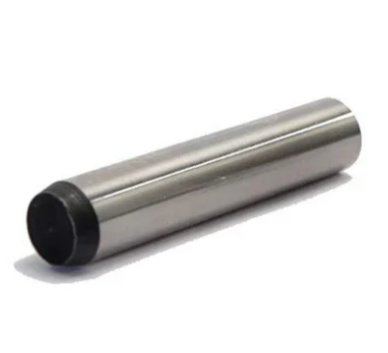
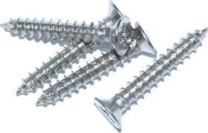
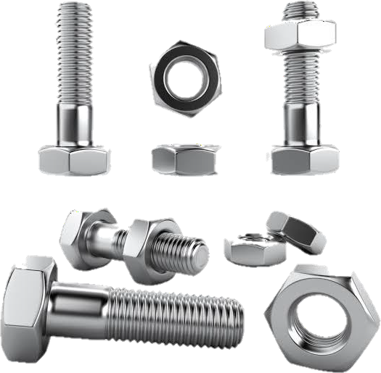
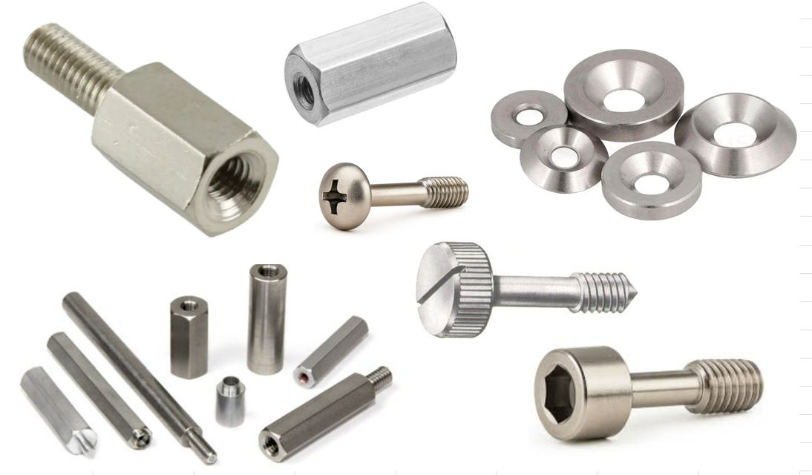
COMPANY PROFILE
VELOCITY ENGINEERING
No.-58, Jamalpur Road,Paposa,
Bhiwani, Haryana,India– 127035 Email - sales@velocityengg.com

Slide 2

Velocity Engineering
Overview :-
Velocity Engineering Your Trusted Partner for Precision Fasteners & Machined Components.
Velocity Engineering, based in Bhiwani, Haryana, India, is a dedicated to delivering high-performance, long-lasting fasteners and machined components that meet the most demanding specifications.
✅ Quality You Can Trust
ISO 9001:2015 certified
    In-house heat treatment and laboratory facilities
Stringent quality control at every stage
    ✅ Reliability Across Industries
    Our robust systems and considerate customer service have earned us the trust of clients across virtually every market segment. We prioritize customer satisfaction above all, ensuring immediate access to product availability and competitive pricing.

Slide 3
Velocity Engineering
✅ Commitment to Excellence
  Consistent product quality
  Quick turnaround times
  Competitive pricing
  Strong R&D and rigorous testing standards
At Velocity Engineering, partnering with us means more than just finding the perfect fit between a fastener and its mate. It means gaining a long-term ally—a growth-oriented company that is committed to improving your business through innovation, productivity, and reliability.

Slide 4
Velocity Engineering
Goal & Vision:-
At Velocity Engineering, our vision is driven by a zeal to outperform competition and earn recognition among leading global fastener manufacturers and distributors.
We are committed to becoming your single-source supplier of world-class components, delivering precision, reliability, and innovation across every product we manufacture.
Our goal is to build enduring partnerships by consistently providing:
Superior quality fasteners and machined components
Competitive pricing with quick turnaround times
Continuous innovation through robust R&D and testing standards
By aligning with Velocity Engineering, you gain more than a supplier—you gain a strategic partner dedicated to advancing your business on a global scale.

Slide 5
Velocity Engineering
Product Expertise:-
Expertise in Industry-Specific Fasteners:
At Velocity Engineering, we bring immense expertise in the manufacture of a broad range of industry-specific fasteners crafted from both ferrous and non-ferrous metals.
Our product portfolio includes precision-engineered fasteners designed for:
Electronics & Electricals
Automotive
Agricultural Machinery
Industrial Applications and Many More
Every fastener is manufactured to meet stringent performance standards, ensuring durability, reliability, and seamless integration across diverse industries.

Slide 6
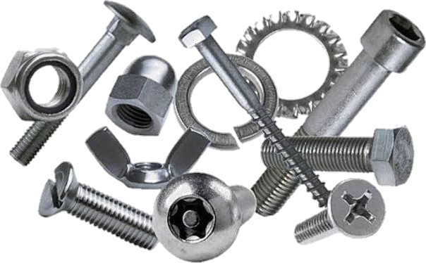
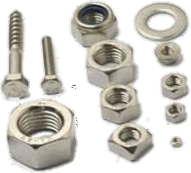
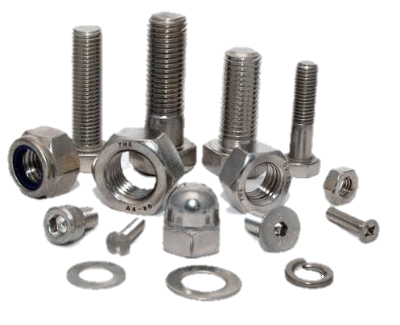
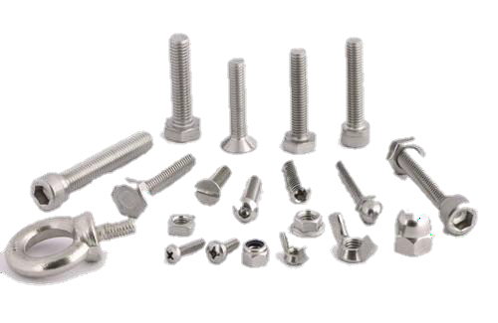
Velocity Engineering
Our Products:-
At Velocity Engineering, we manufacture a wide range of precision fasteners and components to meet diverse industry needs. Our product portfolio includes:
Screws
      Socket Head Cap Screws
      Hex Head Screws
      Slotted Screws
      Captive Screws
      All Types of CSK Screws
Nuts
  Hex Nuts
  Weld Nuts
  Square Nuts
  Cap Nuts
Washers
  Plain Washers, Conical Washers
  Spring Washers

Slide 7
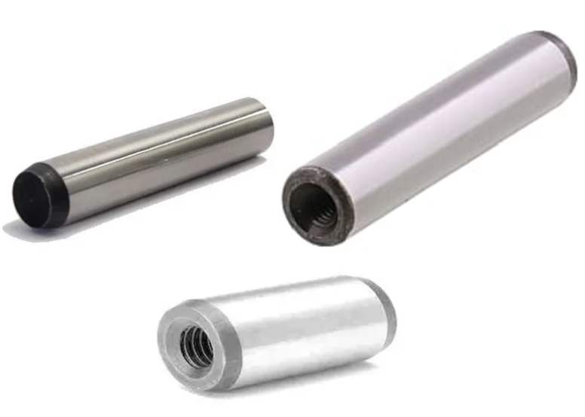
Velocity Engineering
Our Products:-
      Pins
      Dowel Pins
      Taper Pins
      Threaded Pins (Dowels)
      Other Components
      Threaded Rods
      Sheet Metal Components
      Spacers
      Standoffs
      Customized Parts (as per client specifications)

Slide 8
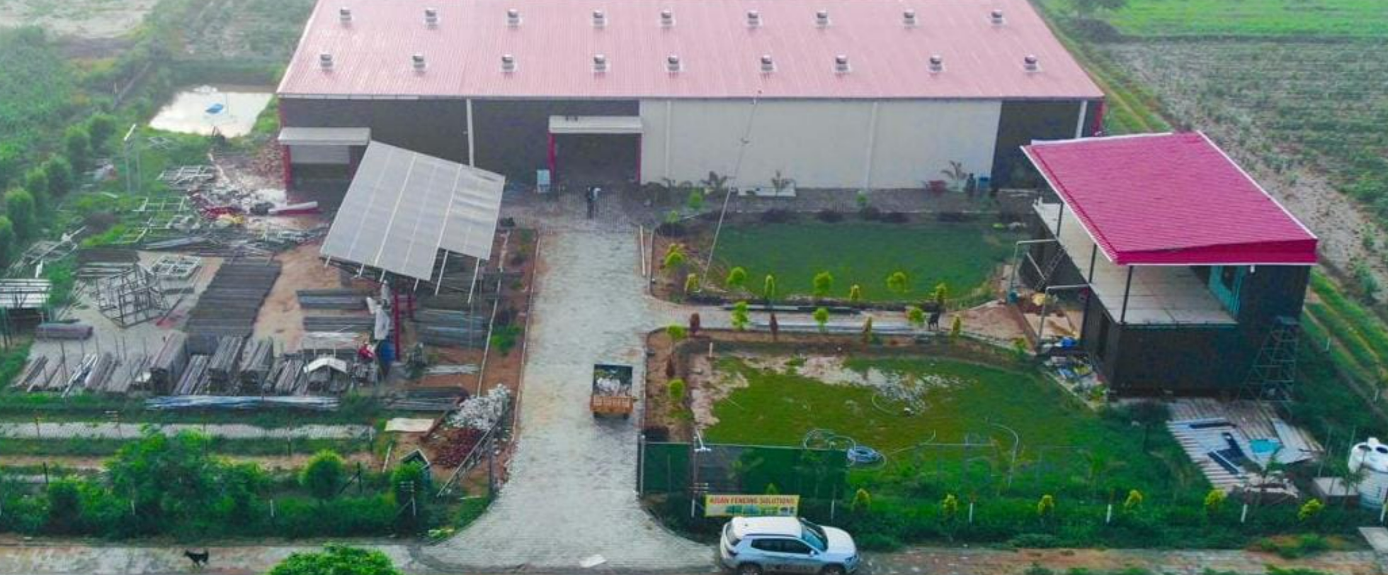
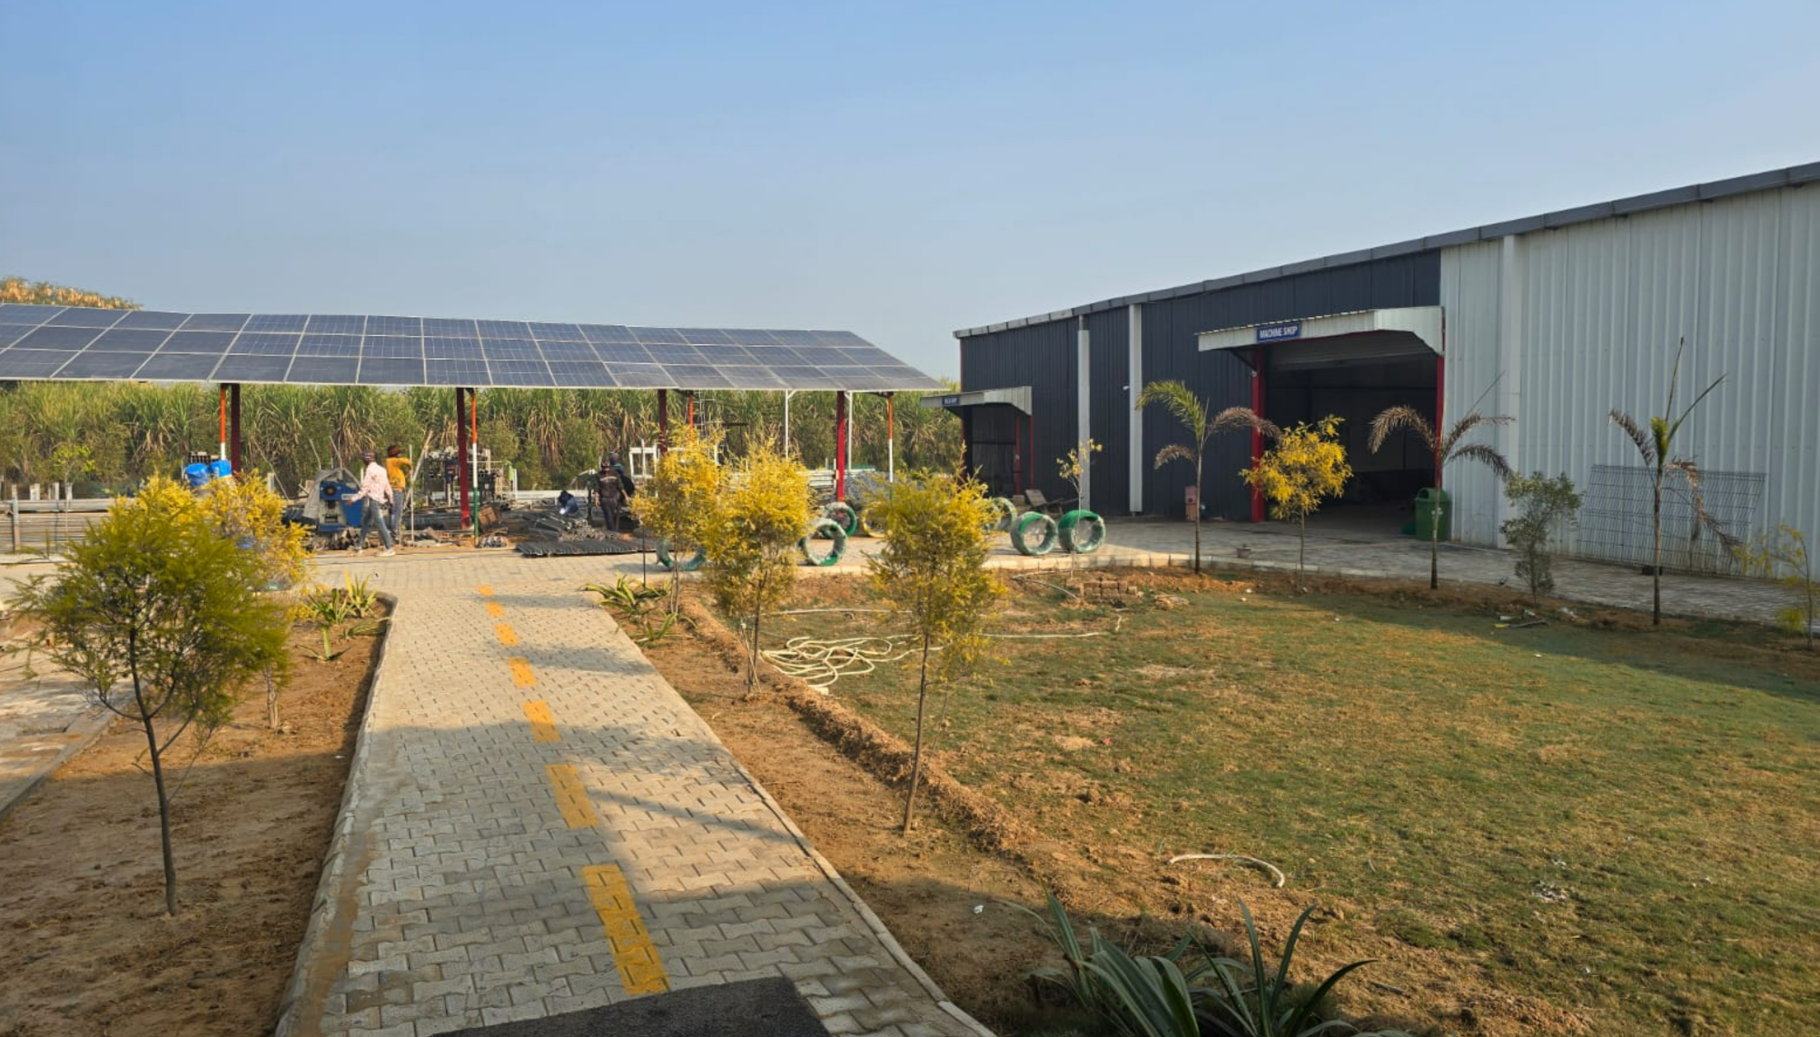
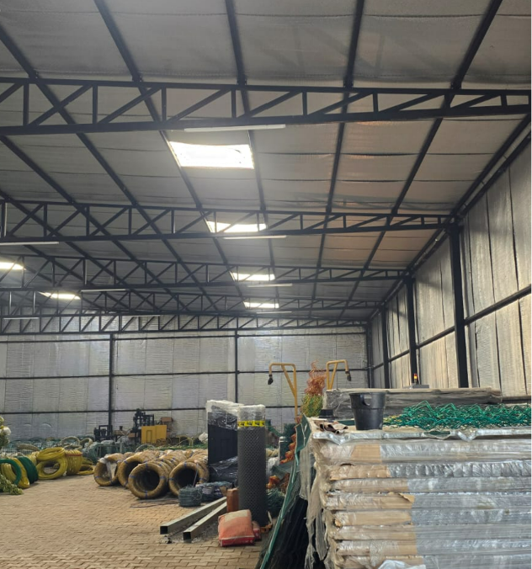
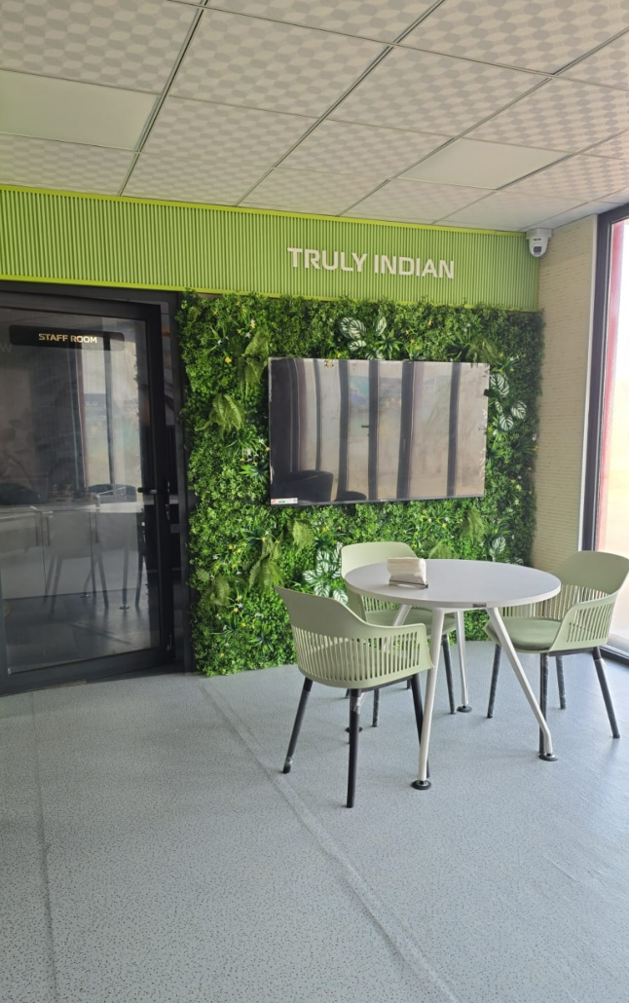
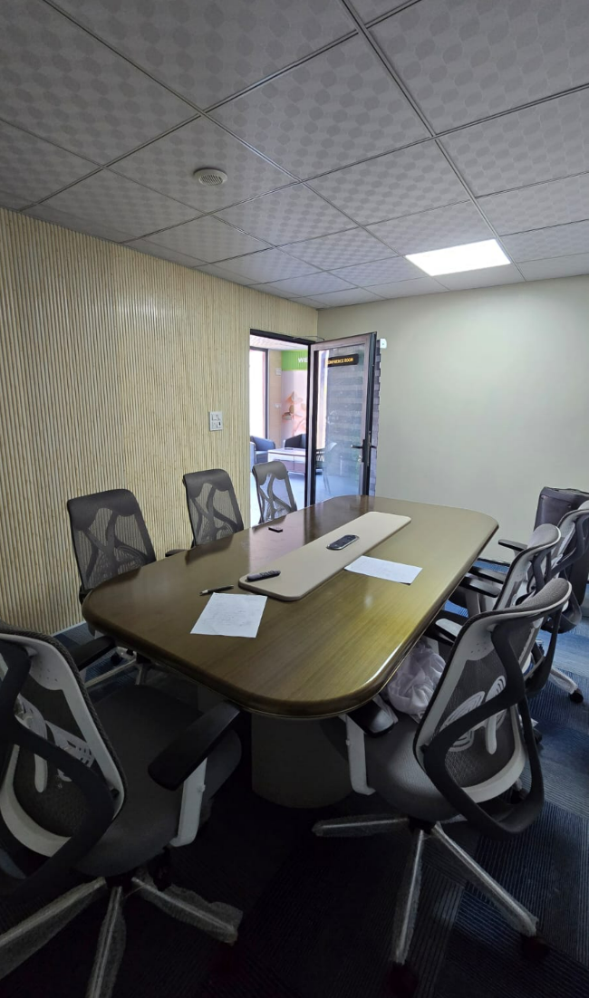
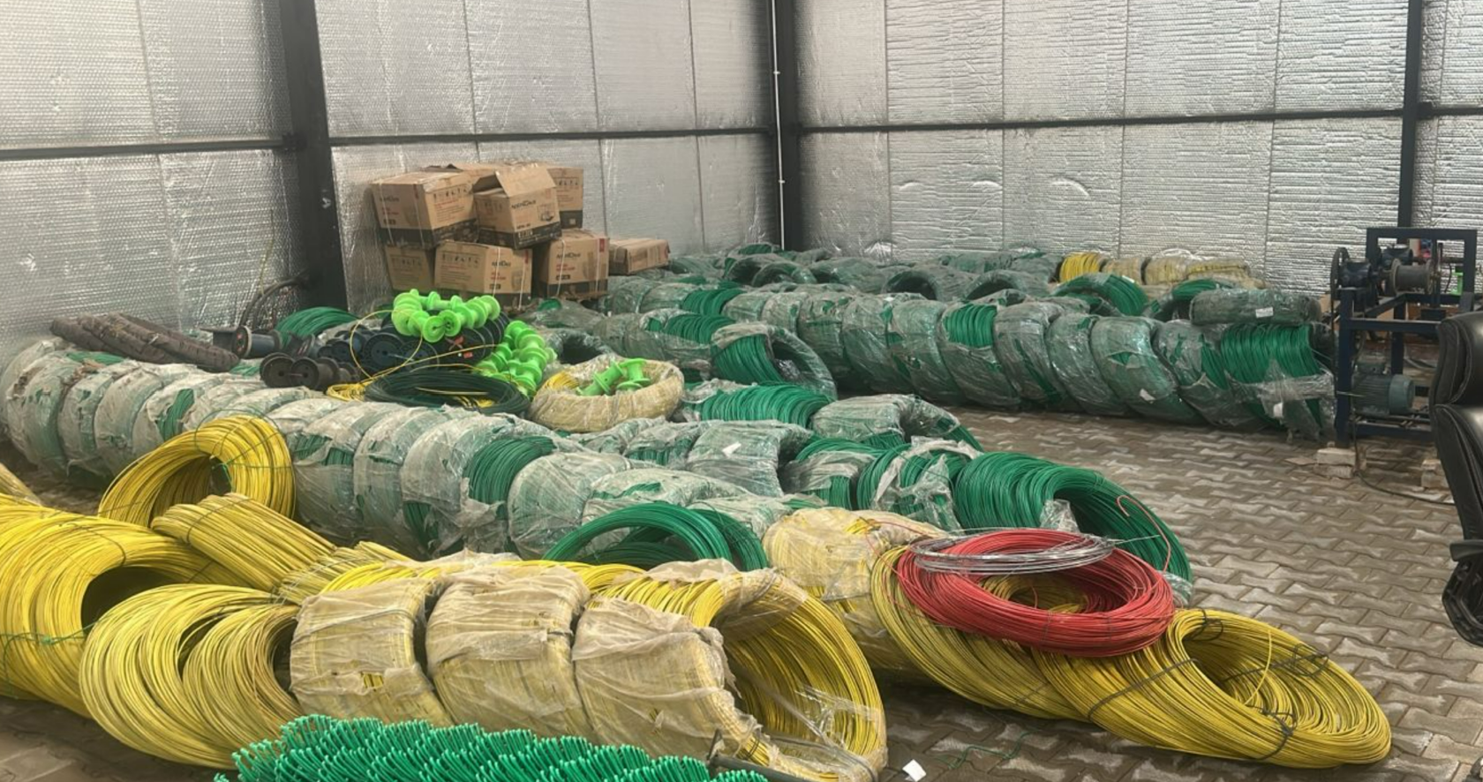
Velocity Engineering
Plants in Pictorial Views:-

Slide 9
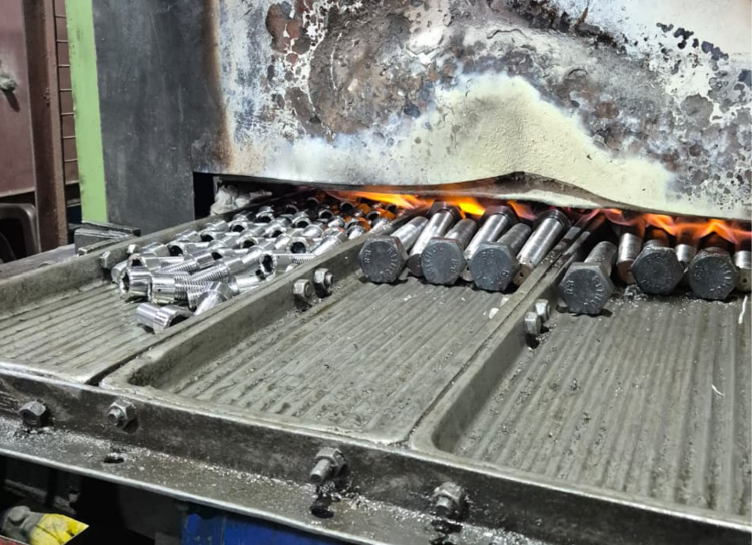
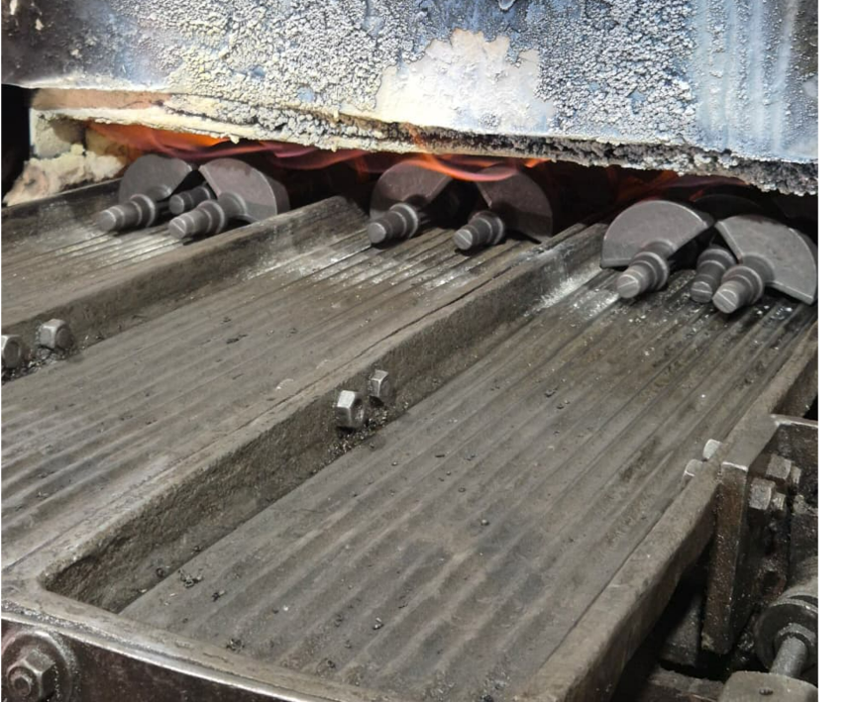
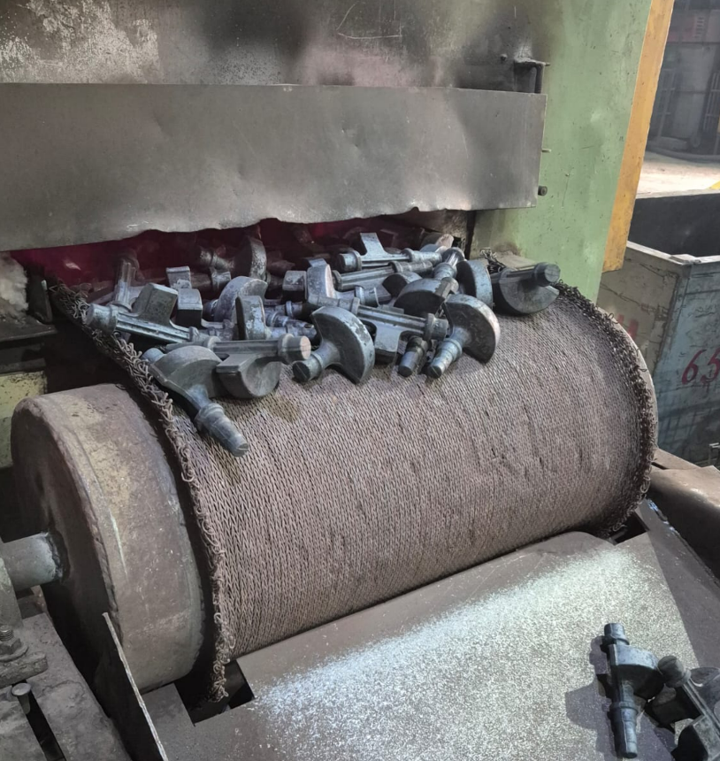
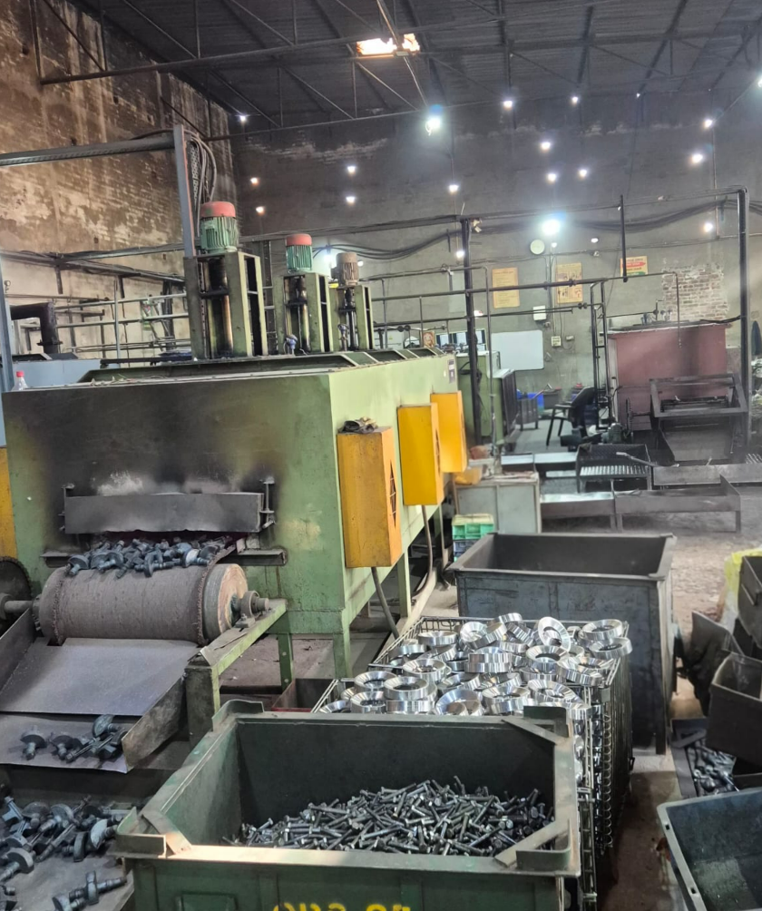
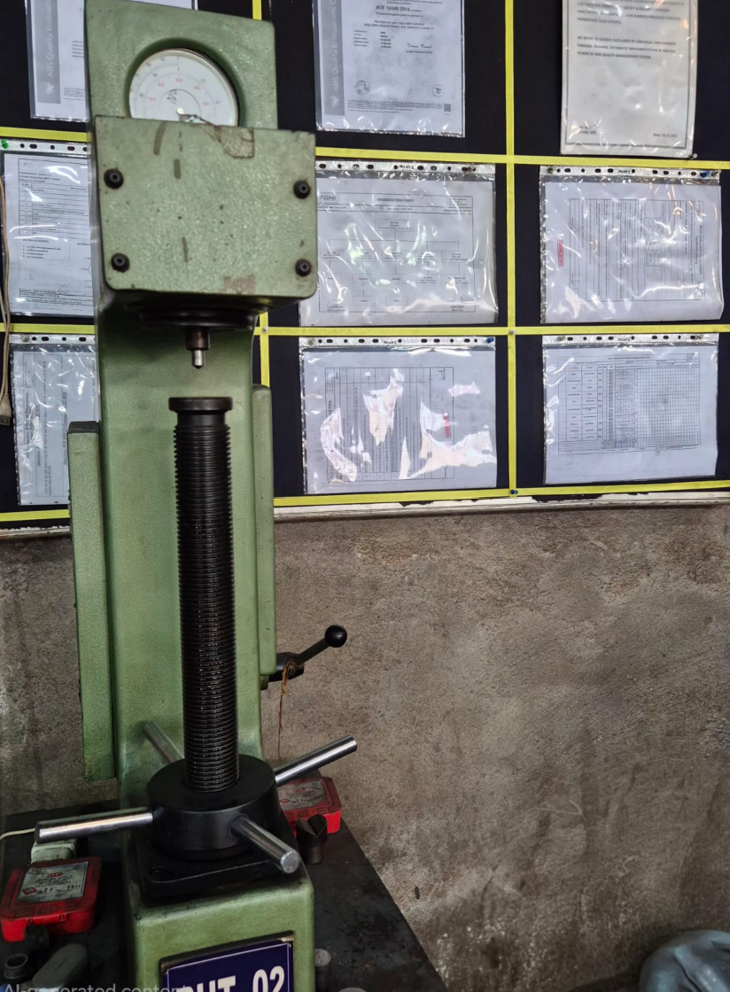
Velocity Engineering
Plants in Pictorial Views:-
Heat Treatment Plant

Slide 10
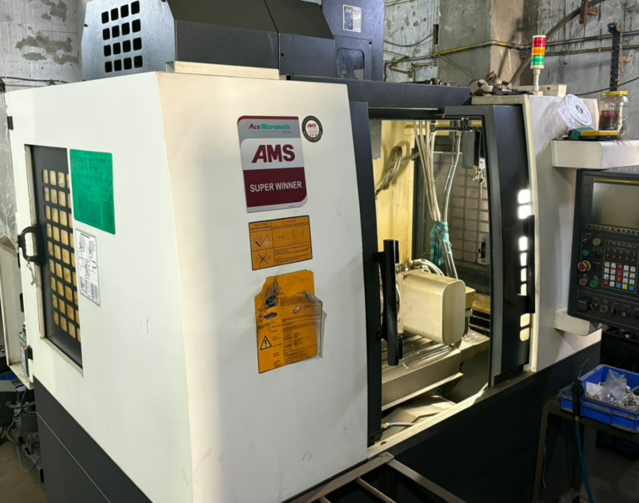
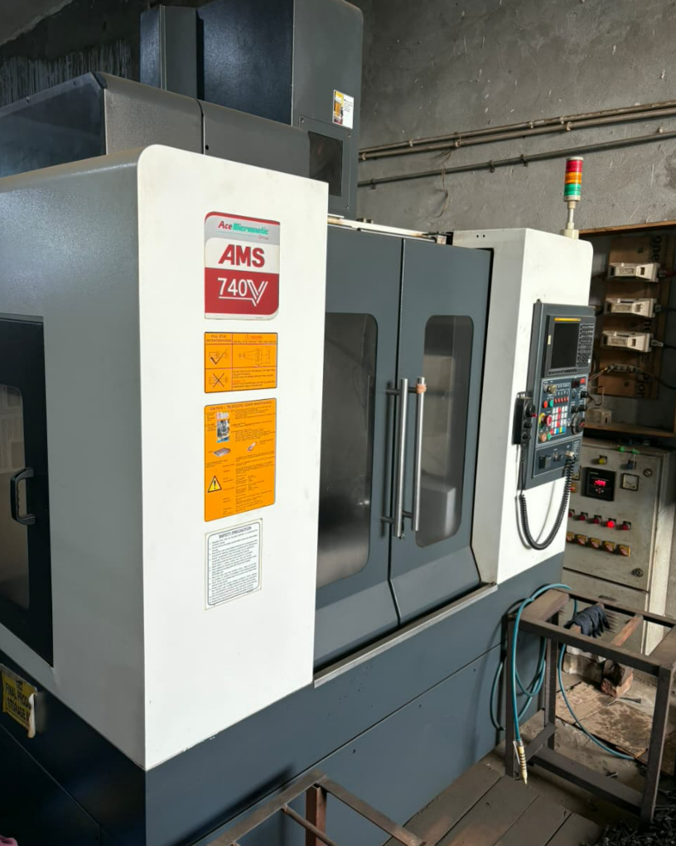
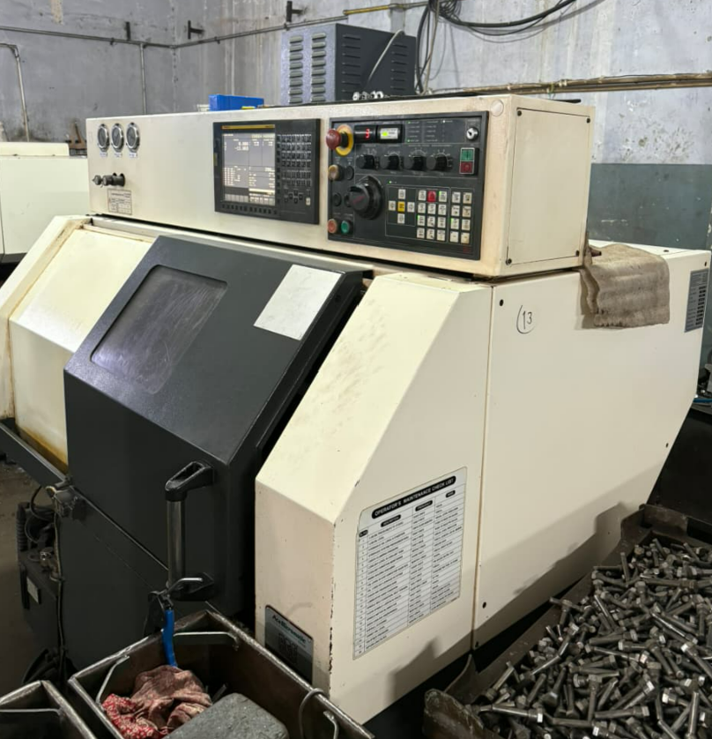
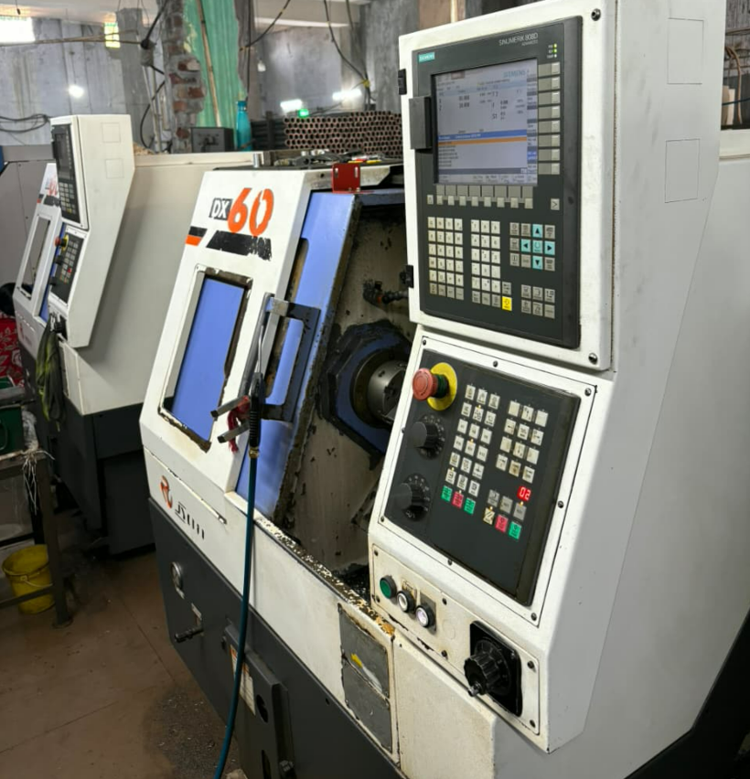
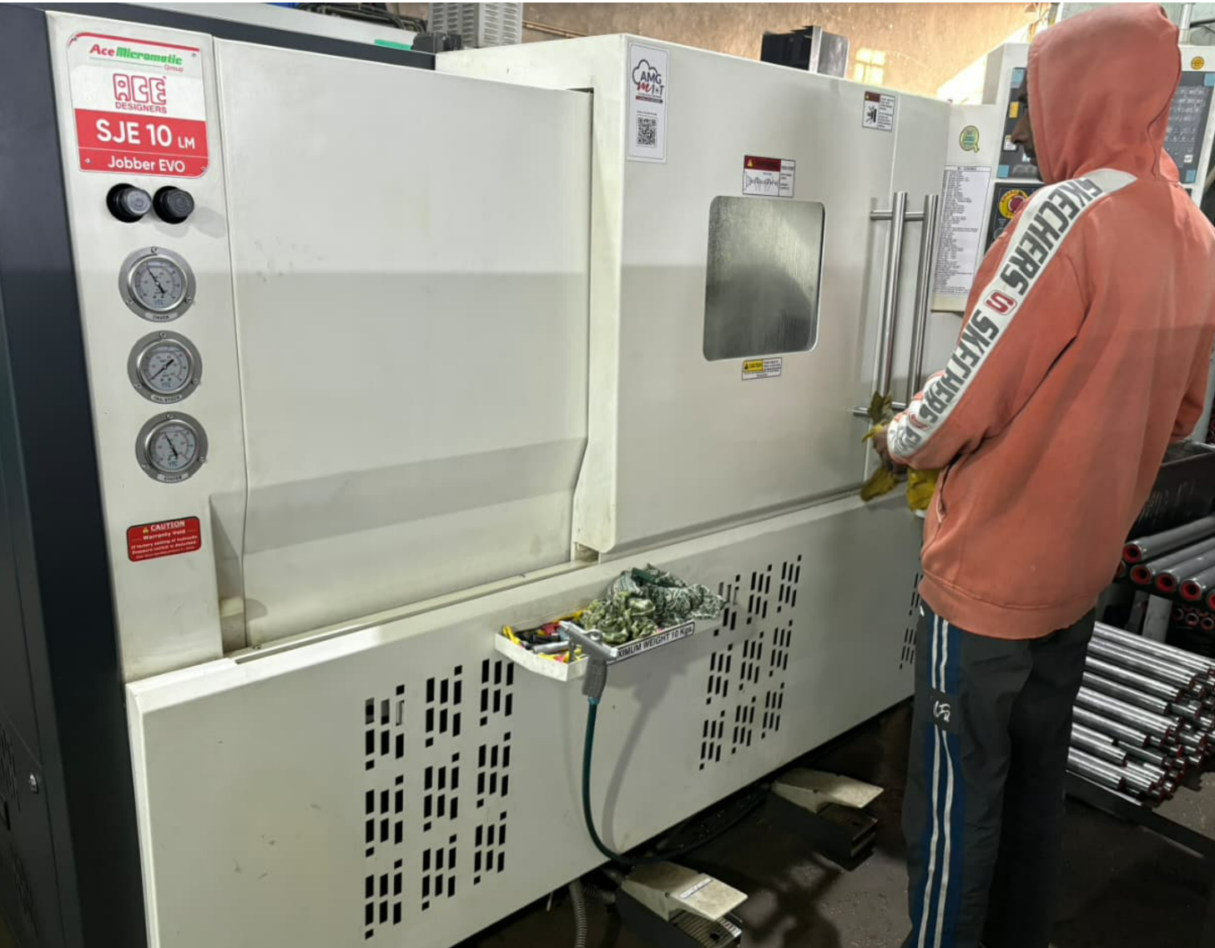
Velocity Engineering
Plants in Pictorial Views:-
Machining Section

Slide 11

Velocity Engineering
For Information & Enquiry :-Mail Us On :-
sales@velocityengg.com
Contact On :-
Deepak Singh (Sales Manager) Mob.:- +91-9812080227

